Slide 1

ARTICLE 32 - SUBCONTRACTING
Motor Vehicle Service Division
Joseph LaCapria, National Business Agent MVS
Dyrike Shaw, NBA southern Region
Instructors:

Slide 2


Article 32
Subcontracting Transportation
Joseph LaCapria
MVS NBA
Dyrike Shaw
MVS NBA

Slide 3
Article 32
Article 32 of the Collective Bargaining Agreement governs all subcontracting violations. Article 32 in conjunction with the handbooks/manuals and applicable documents expand the limitations placed on subcontracting decisions.
Article 32.2 identifies subcontracts for highway transportation.
Article 32.1 covers all other subcontracting violations which may also include transportation contracts not governed by Article 32.2
Subcontracting of transportation and vehicle repair does not automatically equate to a contract violation.
The training is designed to protect the bargaining unit and help recognize violations of Article 32, handbooks/manuals and/or subcontracting MOU’S.
Determinations that subcontracting resulted in a violation, require documentation to support the remedy requested.

Slide 4
Subcontracting violations?
Are contractors performing work historically and/or traditionally performed by the bargaining unit?
  HCRs transportation of all classes of mail and/or equipment.
  Investigate to determine if the manner in which the service was subcontracted is a violation.
  A remedy may include liability, return of work and/or a cease and desist order.

Slide 5
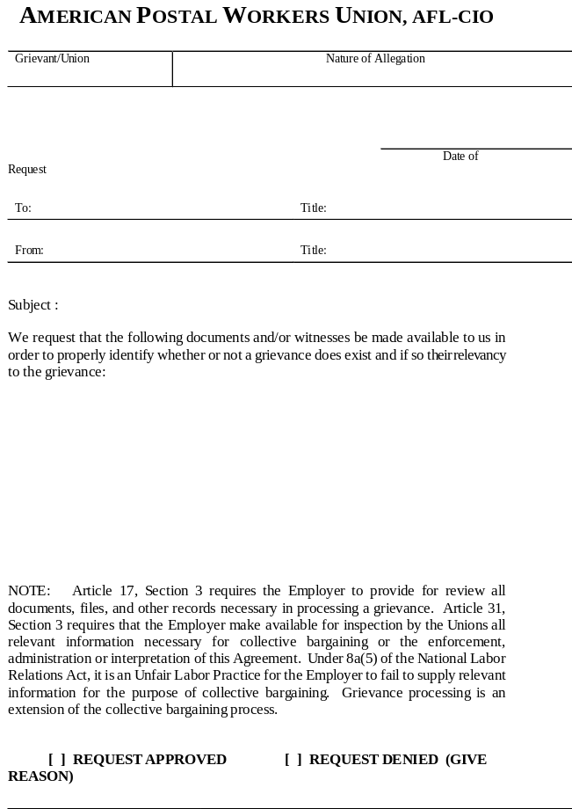
Start the investigation!
Investigations determine if the service violated the CBA in the manner they subcontracted. Postal Vehicle Service (PVS)/ Highway Contract Route (HCR) violations.
Request information in order to determine which HCR contracts service in and out of your facility.
Article 32.2 Transportation subcontracts require specific notice and information. Departure/arrival times, frequency, duration, origination destination, annual mileage hours, effective date of HCR contract and if the proposed contract is new service, renewal or replaces existing PVS in part or in whole.
The service is required to give due consideration prior to the final decision being made to subcontract certain highway transportation. All of the required information must be requested, including the proposed costs, in writing.

Slide 6
statement of schedule and service for STC 10-11-21 Mid Island.pdf

Slide 7
2005 STC cook book
September 29, 2021 STC Southern OIG report
Arb on HASP STC

Slide 8
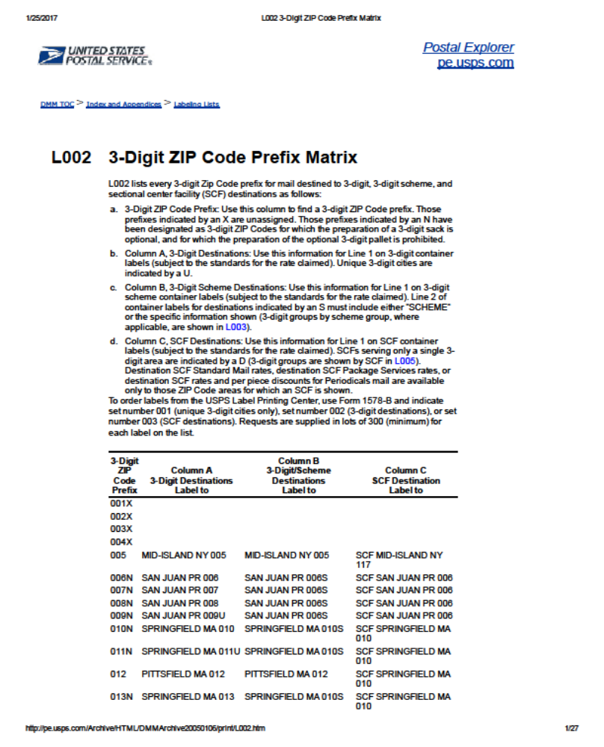
USPS Code Prefix Matrix for all areas, will help determine the designated 3 digit Zip in your facility.

Slide 9
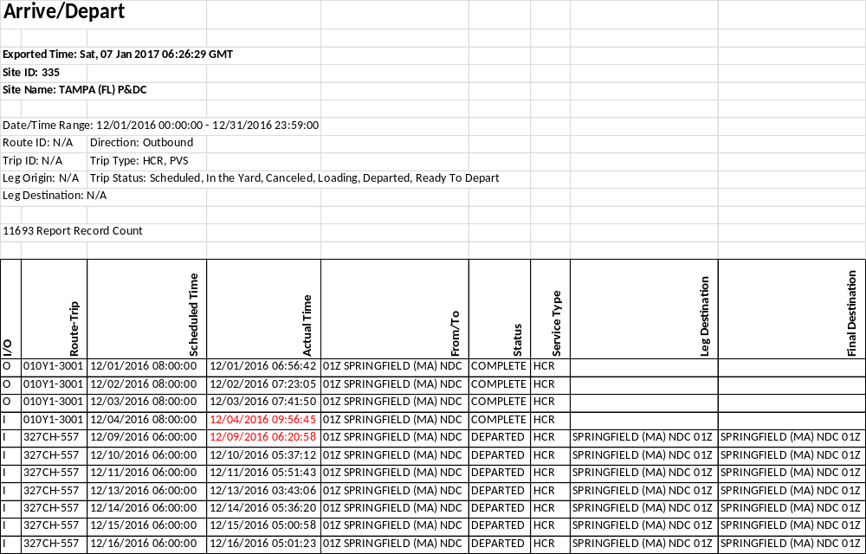
HCR investigation
Your Facility Name

Slide 10
Where to find it?
The TIMES report can be exported into excel if requested in an electronic format. This determines which HCR contractors are operating in and out of your facility. Normally HCR routes that originates from you faculty will begin with the facility code and may have the first 3 digits of the ZIP codes your office covers.
The row labeled Route-Trip this is the row that we will be looking for the 3 digit prefix for your facility. The facility codes usually indicate the origination (starting point/origination/destinations) of HCR routes. The HCR number is a service designation and only serves to track the HCR routes.
The determine service points. After finding all the contracts that transport mail and equipment in and out of your facility and you identify specific HCR routes. The actual HCR contracts can be requested and investigated.

Slide 11
Request HCR route numbers, successor contracts
5443 Contract route statement, schedule and specifications.
7406 Amendment to transportation services
7440 (or 7440AT) Contract route service order.
7405 Transportation services or proposal & contract for regular service.
7409 Notice of acceptance for transportation services or proposal.
5397 Contract Route Extra Trip Authorization
5429 Certification/Payment for Extra Service
Copy of USPS notice Any/all of decision to subcontract to the APWU
Statement of service and schedule/ Consideration and results of evaluation for need to subcontract 5 factors

Slide 12
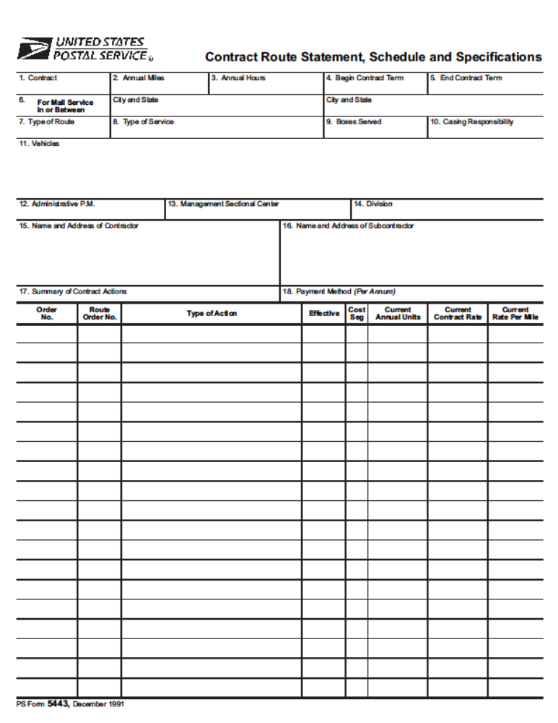
Sample of 5443 Contract Route Statement, schedule and Specifications.

Slide 13
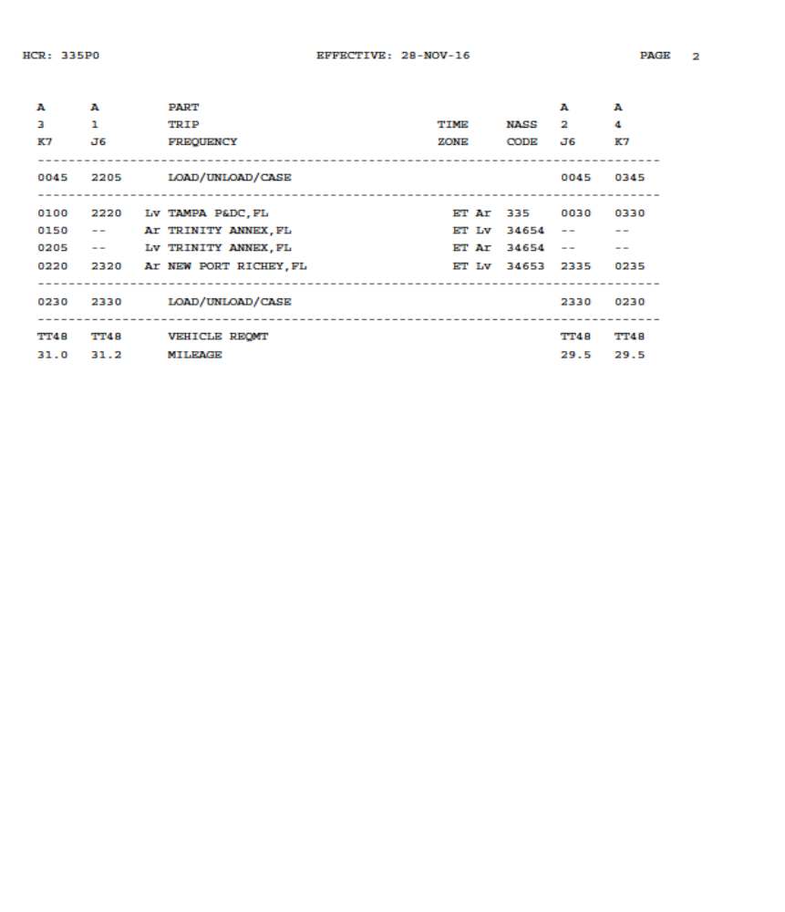
Reading and understanding HCR Statement of Schedule and Service.

Slide 14
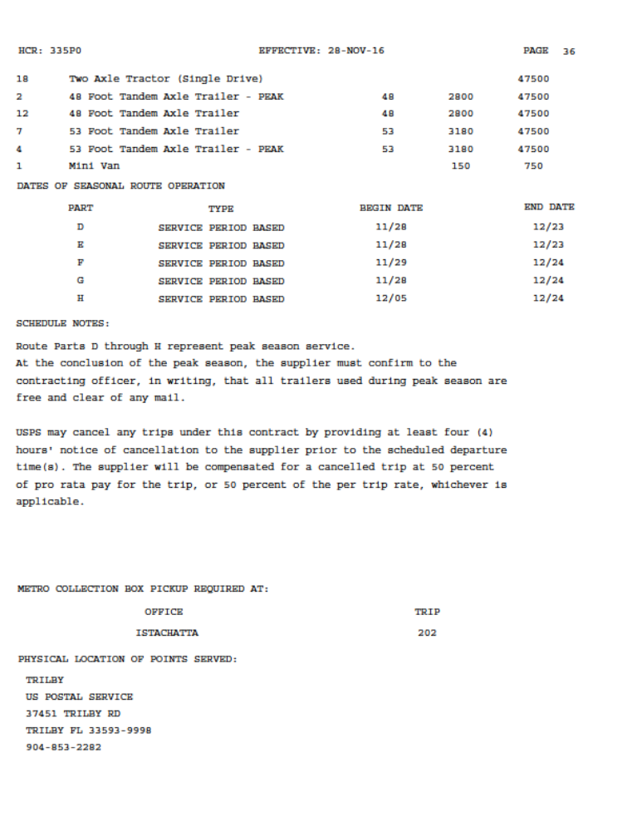

Non notification of this change and additional transportation is a violation.
D through H are each separate segments within this contract. A grievance should be filed for each segment if there was a notice violation and if PVS can provide transportation at a better value

Slide 15
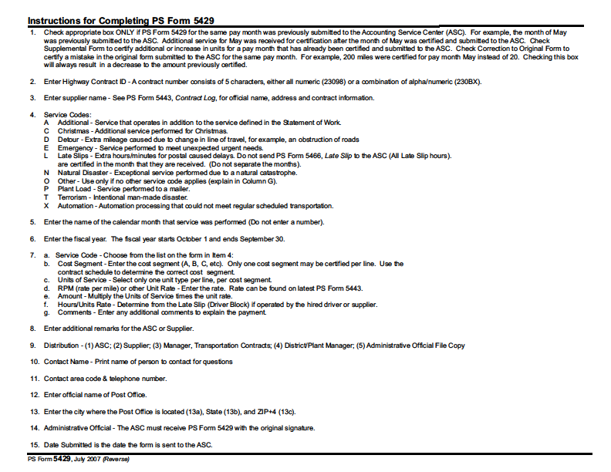

Slide 16
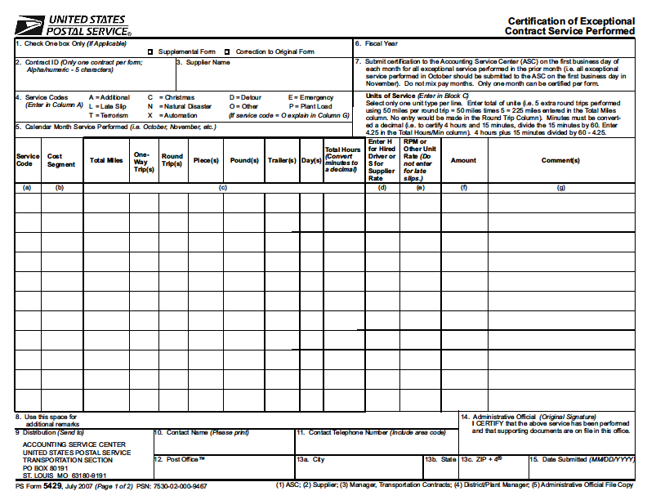

Slide 17
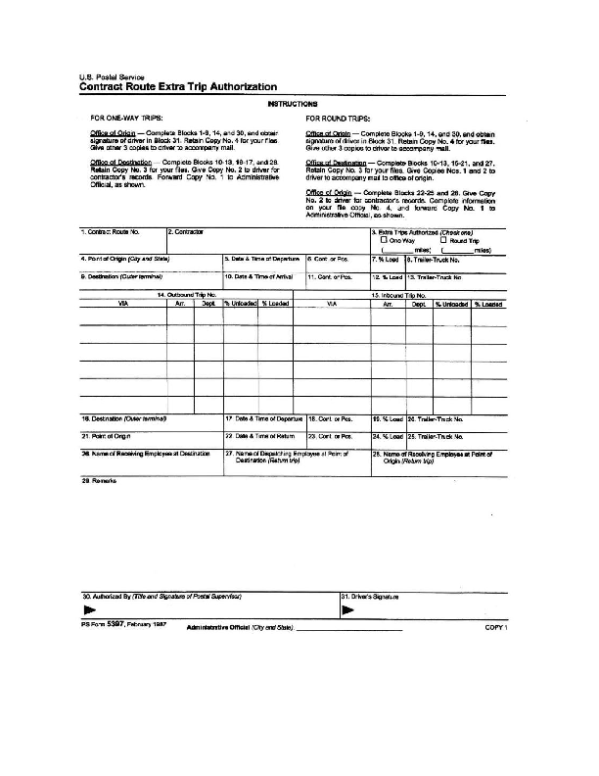

Slide 18
OIG report on 5397’s Sept 17, 2018

Slide 19
OIG report on usage
of 5397s

Slide 20
MEMORANDUM OF UNDERSTANDING
BETWEEN THE UNITED STATES POSTAL SERVICE
AND THE AMERICAN POSTAL WORKERS UNION, AFL-CIO
SUBJECT: Motor Vehicle Craft Jobs
The United States Postal Service (USPS) agrees to fill/create certain positions in the Motor Vehicle Craft of the American Postal Workers Union (APWU), AFL-CIO in accordance with
the following provisions:
2c. The APWU may initiate and obtain a cost comparison on segments (trips) of an HCR route: that is some, but not all, the routes covered by the contract. If the APWU fair comparison of a contract or a segment of a route shows that it would cost less to have the work performed by MVS employees, it will be assigned to MVS employees.

Slide 21
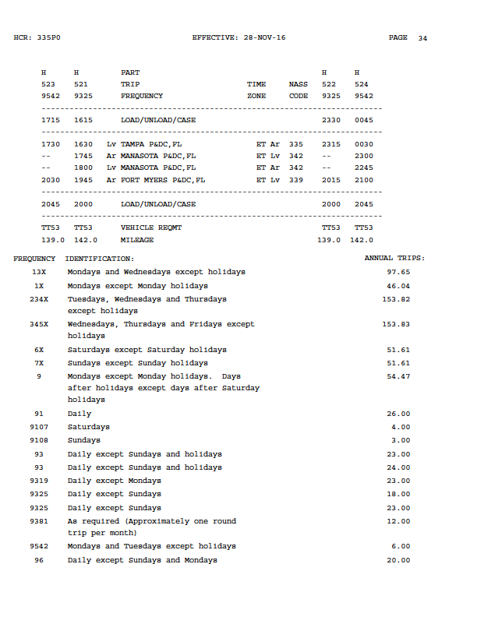
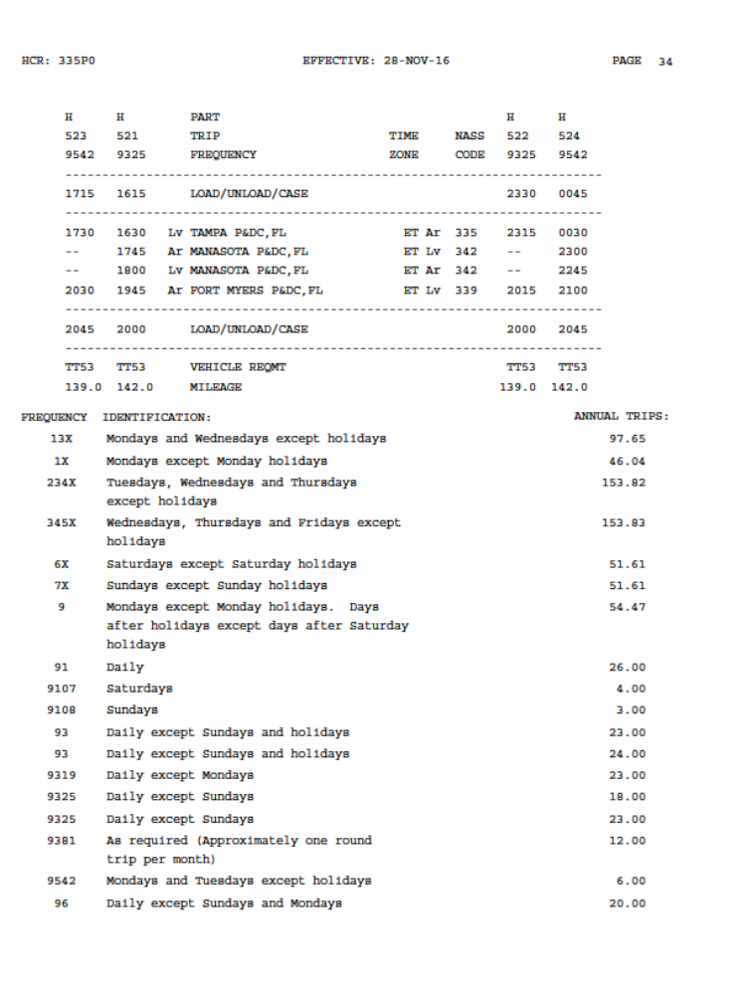
Please note the Statement of Service records HCR frequency (determined by code) which may vary for each HCR trip. Origination destination frequency and equipment requirements are specific and on an annual basis. Normally when the proposed start date differs from the effective date; this means the HCR contract was changed and the effective date is the date the HCR did this transportation service, you will need both schedules. Please note at the bottom TT 53’/139 miles. This requires a 53’ trailer and total mileage 139. The columns are read vertically. Top to bottom and bottom to top.

Slide 22
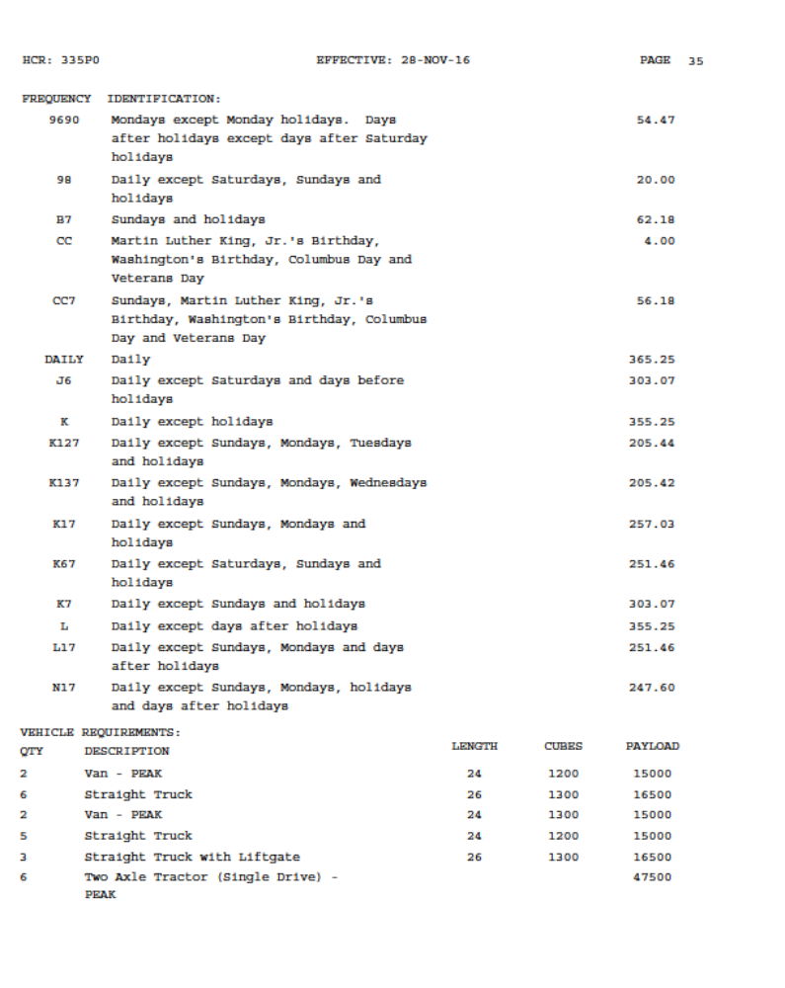

Specific vehicle type required to perform the transportation is listed in each HCR contract.

Slide 23
Knowing what information you requested is crucial
7440 (or Form 7440AT) Contract Route Service Order tells you who authorized the service changes and describes those changes. The form is maintained locally in the AO's files. (P0-501 , Section 441 c)
5443. Contract activity log and Route Statement, Schedule and specifications will list any changes made to the terms of the contract during it's lifetime, the effective dates of any changes and how it affects the annual mileage, rate of pay or rate per mile compensation as applicable. This form is maintained locally in the AO's files. (P0-501 , Sections 221b and 442e)
7405, Transportation Services or Proposal & Contract for Regular Service will tell you the contract number, date of solicitation, beginning and ending dates the contract is in effect, the cities and state(s) that the mail transportation service will run between, the rate of compensation, bid or proposal, who the bidder/vendor are and identifies the U.S. Postal Service official that caused this contract to be executed. The form is maintained locally in the AO's files on the contractor. (P0-501, Section 212.2b and 221)

Slide 24
Information requested
7409, Notice of Acceptance- transportation Services Contract Bid or Proposal for Regular Service, the terms the contractor accepted. The contract number, date of solicitation, beginning and expected ending dates of the contract, the rate of compensation, the contractor's name and address and the signature and title of the postal official who authorized the contract. This form is maintained locally in the AO's files on the contractor. (P0-501, Section 221a)
The Statement of Service and Schedule will tell you the times and locations the contractor must show up and where he must go. It also tells you the mileage and frequency of every trip the contractor is required to make. Included are the actual address of points served and equipment required. Similar to PVS 4533, in a dramatically different format.
7406, Amendment to Transportation Services Contract. If available will show who authorized any amendment to an HCR contract and the specific transportation amendment(s). Each PS Form 7406 generated will have a corresponding line item entry on the PS Form 5443 contract activity log, in the HCR's file. Maintained locally in the AO's files. (P0-501 , Section 442b)

Slide 25
HCR Information Requested
5397 records all extra service which is in addition to all scheduled HCR service
5429 records the payment for each type of extra service for HCR routes
Many HCR contracts operate without an HCR number and are recorded and only exist via extra service and will not be supplied unless specially requested as referenced herein
Requesting this information is just another means of gathering HCR transportation information
The actual contract lists where all of the forms have been maintained and who is the administrative official. Normally the TANS manager is the designated administrative official, in writing noted in the individual HCR contract.

Slide 26
Information RFI template

Slide 27
Notice on Small Parcel Annex (SPA)

Slide 28
Sample Grievance on STC’s
The appeal is an example of an actual appeal for a violation which includes a lot of information. RFI’s, statement of schedule and service, as well as other information to use as a template for similar appeals.

Slide 29
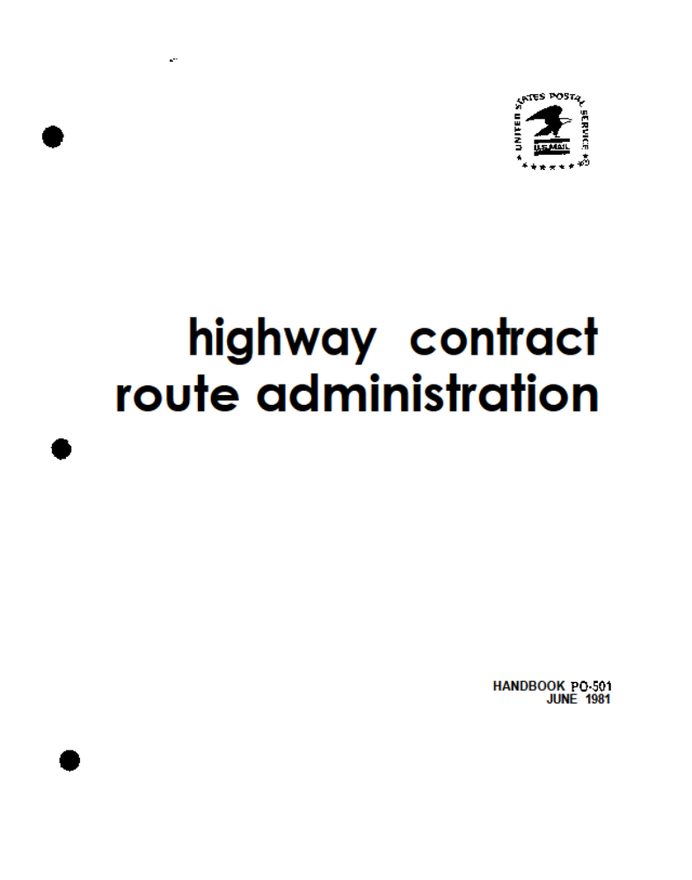

PO-501 Highway Contract Route Administration. This manual is loaded with information on the who, what, and where of Highway Contracts.

Slide 30
Notification
Article 32.1C. When a decision has been made at the Field level to subcontract bargaining unit work, the Union at the Local level will be given notification.
Article 32.2B. For highway contracts covered by Article 32, Section 2, the Union will be furnished the information enumerated in Paragraph C below. This information will be furnished at least sixty (60) days prior to the scheduled installation of the service. Within forty (40) days of being furnished such information, the Union may request a meeting to discuss a specific contract(s). Within forty-five (45) days of being furnished such information, the parties will exchange the basic cost analyses in order to facilitate discussions. The parties will meet on or before the sixtieth (60th) day. At no time will the subject highway contract(s) for which a meeting has been requested be awarded prior to the actual meeting.

Slide 31
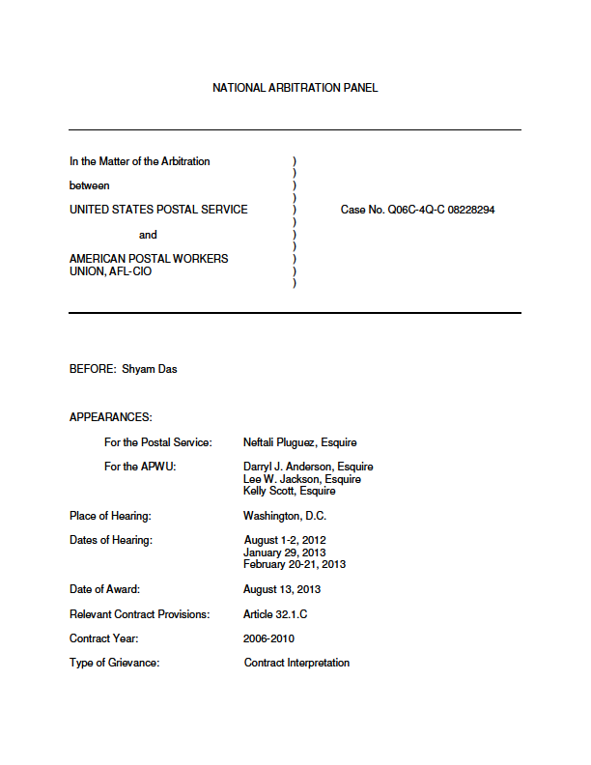
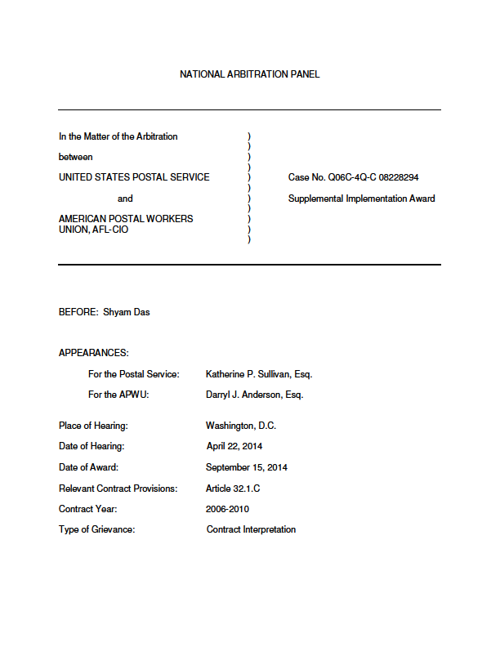
National level awards which determined that the union at the local level must be notified of subcontracting decisions
Article 32.1.C Notice to local the union field/local level is contractually mandated of all subcontracting decisions entered into.
First Award
Supplemental Award

Slide 32
Awards
Article 32.1.C requires notification to the local union of decisions to subcontract bargaining unit work at local installations made at the local, as well as district or area, level is sustained.
Subcontracting excluded from coverage under Section 2 of Article 32, as provided in Article 32.2.H, is not exempt or excluded from coverage under the notice provision in Section 1.C of Article 32.

Slide 33


Determining Violations
Grievances filed for non notification violations are contractually limited to the 14 day window of when the violation was determined.
32.1.C Is always utilized when the local union is not notified
32.2.G has specific qualifying criteria :
1. A fixed annual rate contract over $100,000 per annum, but not more than 350 miles in round-trip length, and
2. An annual rate or non-annual rate contract such as local drayage, spotting or shuttle service where the estimated annual compensation will exceed $45,000, and
3. Not more than 8 hours in operating time from terminus to terminus.
4. Being then operated by bargaining unit employee(s) of the Motor Vehicle Craft, regardless of annual cost, round-trip length or operating time.

Slide 34
MEMORANDUM OF UNDERSTANDING
BETWEEN THE
UNITED STATES POSTAL SERVICE
AND THE
AMERICAN POSTAL WORKERS UNION, AFL-CIO
Re: Highway Contract Route (HCR) Limitation
1. For the term of the 2015 National Agreement there will be a moratorium on any new subcontracting of mail transportation by Highway Contract Route (HCR) pursuant to Article 32 in offices where Postal Vehicle Service (PVS) drivers are currently employed.
2. Specifically included in the moratorium is the nationwide subcontracting of all Postal Vehicle Service pursuant to Article 32.1.B and any “mode conversion” of PVS to HCR at a specific facility, and any new conversions from PVS to HCR.

Slide 35
  3. Specifically excluded from the moratorium are those HCR contracts currently in effect. The renewal of these contracts shall be in accordance with the provisions of the National Agreement. The renewal of contracts may also include adjustments to existing contracts to account for additional service points that are added in consideration of service standard changes, changes in service areas, and/or emergent business needs of postal customers.
  The 2010 and the 2015 CBA and National Arbitration Awards, place serious limitations on subcontracting. Work must be performed in-house when union proves the bargaining unit can preform the work at an equal or better value.

Slide 36
MEMORANDUM OF UNDERSTANDING
BETWEEN THE
UNITED STATES POSTAL SERVICE
AND THE
AMERICAN POSTAL WORKERS UNION, AFL-CIO
Re: Contracting or Insourcing of Contracted Service
  It is understood that if the service can be performed at a cost equal to or less than that of contract service, when a fair comparison is made of all reasonable costs, the work will be performed in-house.

Slide 37
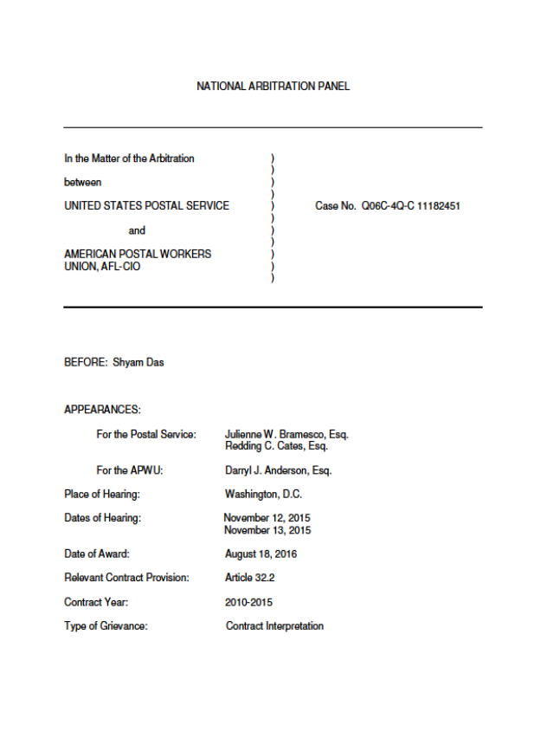
National Award - Non Notification!
The Postal Service violated the National Agreement by notifying the Union of HCR contracts after they have been let. The Postal Service is ordered to cease and desist such violations and to comply with the notice and procedural provisions of Article 32.2.B before it awards a Highway Contract Renewal (HCR) contract. The Postal Service also is ordered to comply with the following remedy:
(1) Within six months of the date of this Award (unless otherwise agreed), the Postal Service shall convert the 110 (or whatever number there continue to be) disputed routes remaining in service (out of the original 212 cited violations) to PVS service for a four-year period.
(2) By agreement, the parties may substitute other route(s) to be converted to PVS service pursuant to this order based on particular circumstances.
(3) I retain jurisdiction to resolve any matters relating to implementation of this remedy.

Slide 38
5 FACTORS
Cost
Efficiency
Qualification of Employees
Public Interest
Availability of Equipment

Slide 39
JCIM Article 32.1.B
It is understood that if the service can be performed at a cost equal to or less than that of contract service, when a fair comparison is made of all reasonable costs, the work will be performed in-house.
APWU

Slide 40

Reviewing the 5 factors
The 5 factors as outlined in Article 32 must be considered when evaluating the need to subcontract and prior to the decision is made. It is crucial to document violations for failure to supply the information or apply the 5 factors.
File a charge with the NLRB to obtain the information if not supplied. Before filling the NLRB charge put a second information request in for the information and please note second request. Document your efforts and include exactly what was received and not supplied..

Slide 41
JCIM Article 17 Q&A 21 - Information requests
21. What information is the union entitled to when investigating a grievance or a possible grievance?
Response: Articles 15, 17, and 31 intend that any and all information which the parties rely on to support their positions in a grievance is to be furnished and exchanged (with the exception of certain medical records). This will foster maximum resolution at the lowest level. Information requests for timekeeping records, leave records, prior discipline records, staffing records, and work schedule records are normally regarded as relevant with respect to the union’s determination whether or not to file a grievance concerning those matters. For such routine requests, no specific explanation of relevancy is required on the union’s request form. Requests for other types of information require the union to show the basis of the information's relevancy.
The law has developed special rules for union requests for information relating to non-bargaining unit members and employee medical information. Information regarding non-bargaining unit members should be provided if it is reasonably probable that the information is relevant to an issue between the parties and would be of use to the union in carrying out its statutory duties and responsibilities.

Slide 42
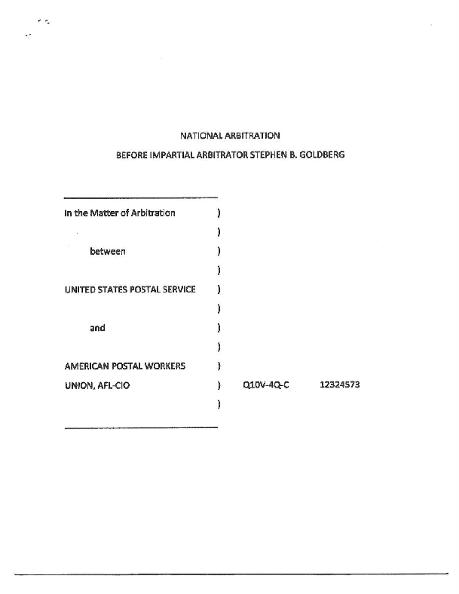
Pre and Post 2010 Contract and Article 32
1. 32.1.B applies to the proposed California mode. Accordingly, the Postal Service must comply with Article 32.1.B before making a final decision on whether or not California PVS work will be contracted out.
2. Article 32.2 does not apply to the California mode conversion.
3. The Memorandum of Understanding Regarding Contracting or insourcing of Contracted Services applies to all contracting out of highway transportation work, including that controlled by Article 32.2.
4. The "fair comparison of all reasonable costs" called for by the Memorandum of Understanding Regarding Contracting or insourcing of Contracted Services is to be made at the times called for by Article 32 – in an Article 32.1.B proceeding at the time the Comparative Analysis report is being developed; in an Article 32.2 proceeding within 45 days of the Postal Service furnishing the Union with the Information called for by Article 32.2.C.

Slide 43
Goldberg's Decision - COST, Page 21
In support of its position, the Postal Service initially points out that the term "cost" as It appears In Article 32.1 and Article 32.2 has been consistently understood and applied by the parties to mean estimated costs. These cost estimates or cost “analyses" (used as a synonym for estimated costs) are typically made on Postal Form 5505; even when they are not, the parties' determination of the costs of contracting out compared to the costs of retaining work in house has always been predicated on estimates of those costs, not on a comparison of the price quoted by the Postal Service's preferred contractor (who may or may not be the lowest bidder) and the Union's statement of the cost of keeping the work In house. As the Postal Service states (Brief, pp. 28-29):

Slide 44
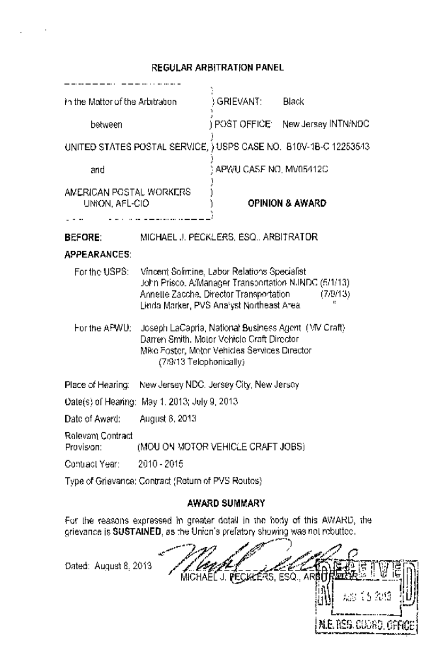
AWARD SUMMARY
For the reasons expressed in greater detail in the body of this AWARD, the grievance is SUSTAINED, as the Union's prefatory showing was not rebutted.
The APWU has established by a preponderance of the credible evidence, that Management violated the CBA, in particular Item 2 Motor Vehicle Services of the MOU on Motor Vehicle Craft Jobs, by failing to return the 12 runs listed at page 13 of Joint Exhibit 2 to the MVS craft from the HCR contractor.
MOU Section 2 Work Returned

Slide 45
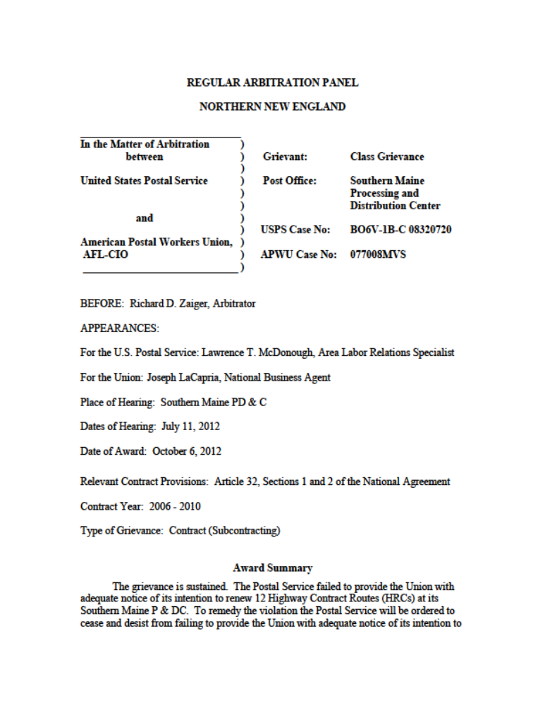
Notification Article 32
The grievance is sustained. The Postal Service violated Article 32 of the parties’ National Agreement by failing to provide the Union at the national level with adequate notice of its desire to renew 12 HCRs on July 1, 2008. The Postal Service is ordered to comply in the future with the notice provisions of Article 32 at its Southern Maine P & DC.

Slide 46
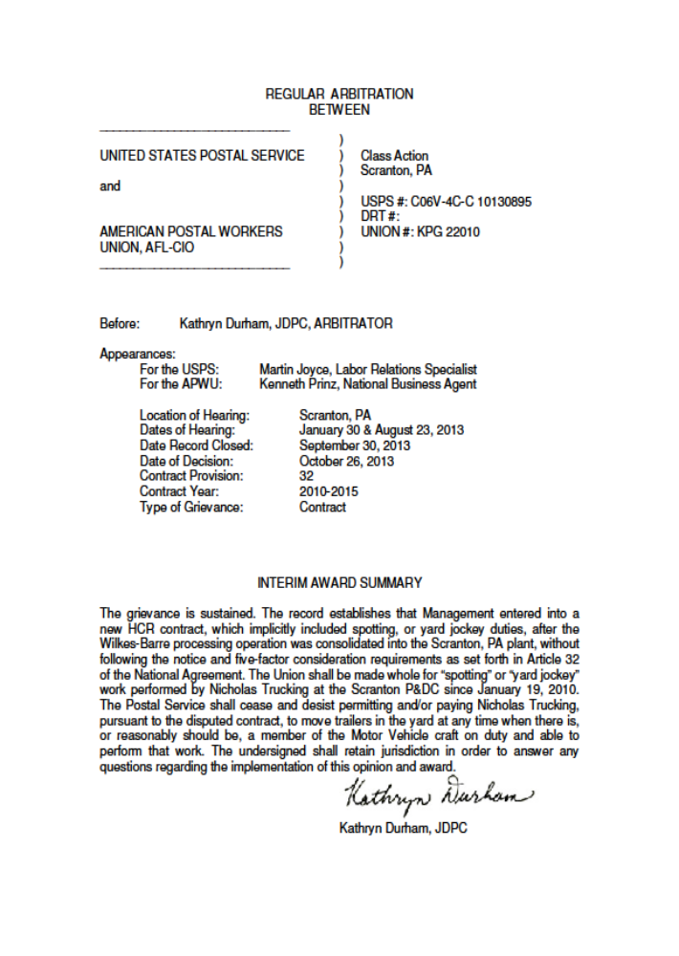
5 Factors in Article 32
The grievance is sustained. The record establishes that Management entered into a new HCR contract, which implicitly included spotting, or yard jockey duties, after the Wilkes-Barre processing operation was consolidated into the Scranton, PA plant, without following the notice and five-factor consideration requirements as set forth in Article 32 of the National Agreement. The Union shall be made whole for “spotting” or “yard jockey” work performed by Nicholas Trucking at the Scranton P&DC since January 19, 2010.
The Postal Service shall cease and desist permitting and/or paying Nicholas trucking, pursuant to the disputed contract, to move trailers in the yard at any time when there is, or reasonably should be, a member of the Motor Vehicle craft on duty and able to perform that work. The undersigned shall retain jurisdiction in order to answer any questions regarding the implementation of this opinion and award.

Slide 47
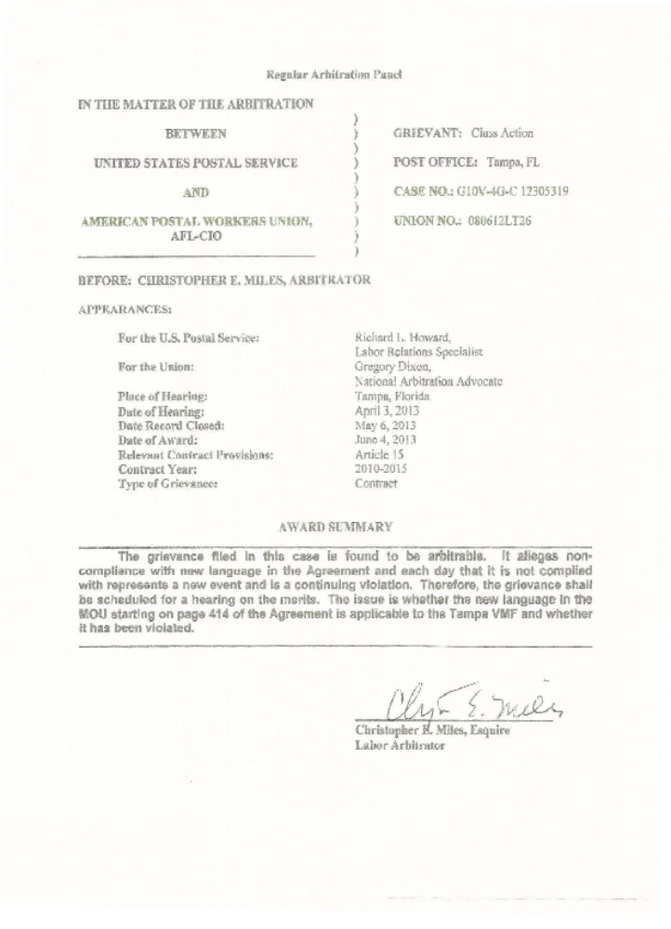
The grievance filed in this case is found to be arbitrable. It alleges non-compliance with new language in the Agreement and each day that it is not complied with represents a new event and is a continuing violation. Therefore, the grievance shall be scheduled for a hearing on the merits. The issue is whether the new language in the MOU starting on page 414 of the Agreement is applicable to the Tampa VMF and whether it has been violated.
Time Limits Latches Article 32

Slide 48
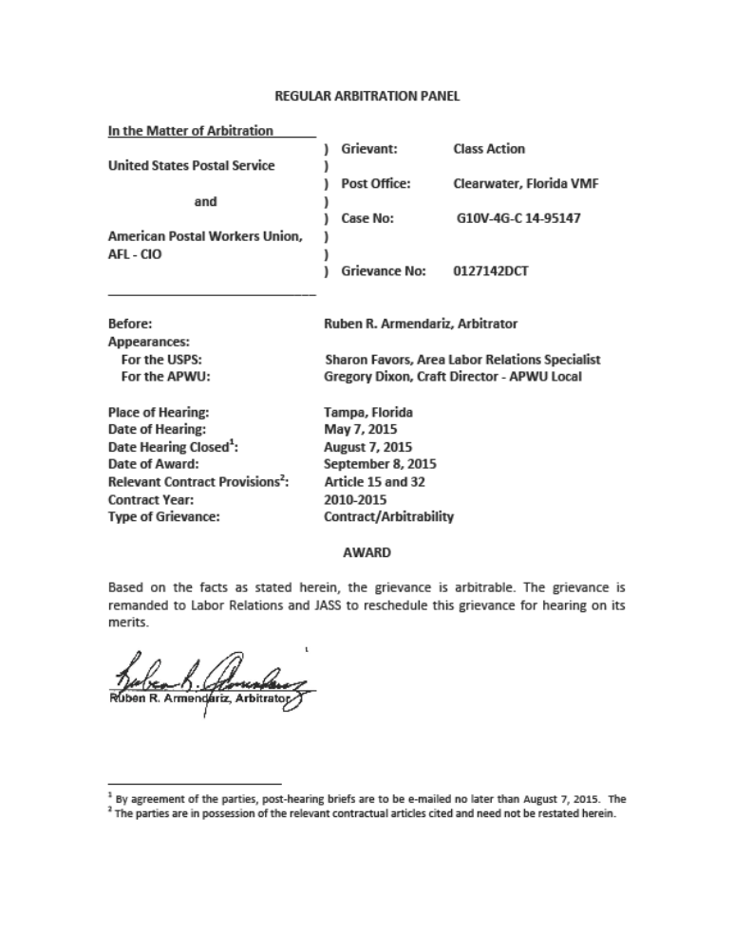
2010 Contract Changed Everything
DISCUSSION AND OPINION
Postal Service raised an issue of arbitrability. Postal Service argues the grievance is not properly before the arbitrator and should be denied on the doctrine of res judicata and collateral estoppel. The arbitrator does not agree. The Postal Service has relied heavily on the award rendered by Arbitrator Linda Byars. That award was issued within the 2006 CBA. While the present grievance does involve the same issue and the same parties, it however, involves the 2010 CBA. The parties negotiated new MOU’s that changed the effectiveness and impacted the standing of the Byars decision.
AWARD
Based on the facts as stated above, this grievance is arbitrable. The grievance is remanded to Labor Relations and JASS to reschedule this grievance for hearing on its merits

Slide 49
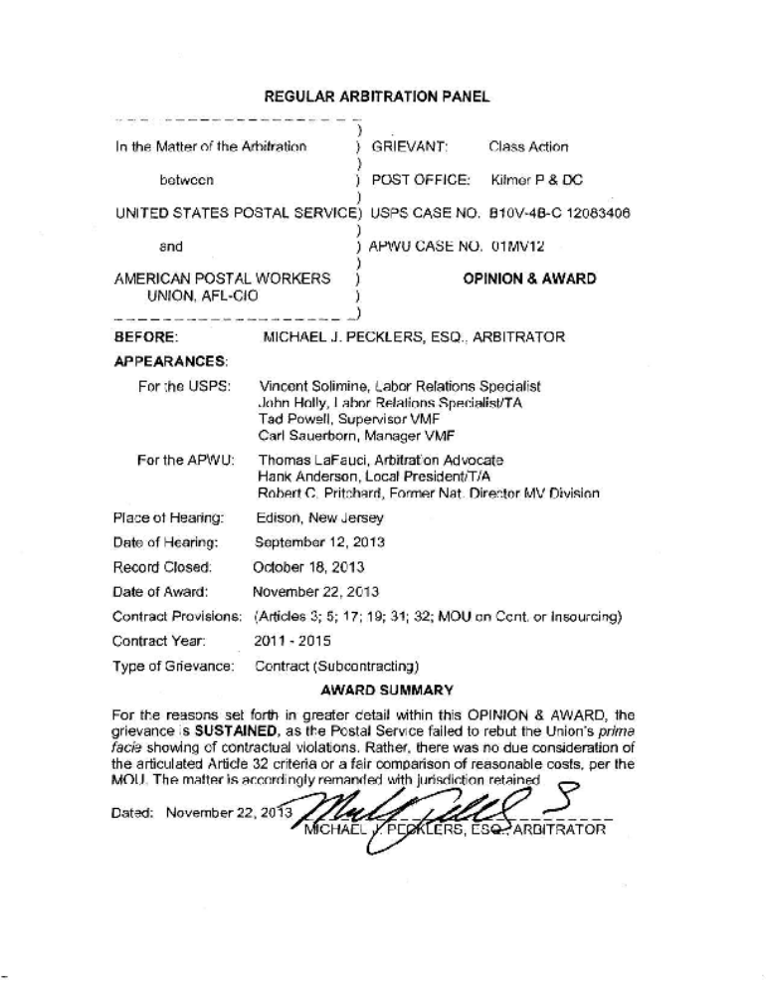
2010 Contract MOU on Cost and Notification
AWARD SUMMARY
For the reasons set forth in greater detail within this OPINION & AWARD, the grievance is SUSTAINED, as the Postal Service failed to rebut the Union's prima facie showing of contractual violations. Rather, there was no due consideration of the articulated Article 32 criteria or a fair comparison of reasonable costs, per the MOU. The matter is accordingly remanded with jurisdiction retained.
AWARD
THE GRIEVANCE IS SUSTAINED. THE POSTAL SERVICE SHALL CEASE AND DESIST FROM VIOLATING ANY OF
THE SUBCONTRACTING PROVISIONS OF THE NATIONAL AGREEMENT IN THE FUTURE. EFFECTIVE FOURTEEN {14) DAYS PRIOR TO THE FILING OF THE GRIEVANCE, ALL CRAFT MEMBERS ON THE OTDL SHALL EQUALLY SHARE THE COSTS OF THE SUBCONTRACTS AWARDED, NOT TO EXCEED WHAT THEY WOULD HAVE ORDINARILY BEEN ENTITLED TO PURSUANT TO THEIR OVERTIME RATE.

Slide 50
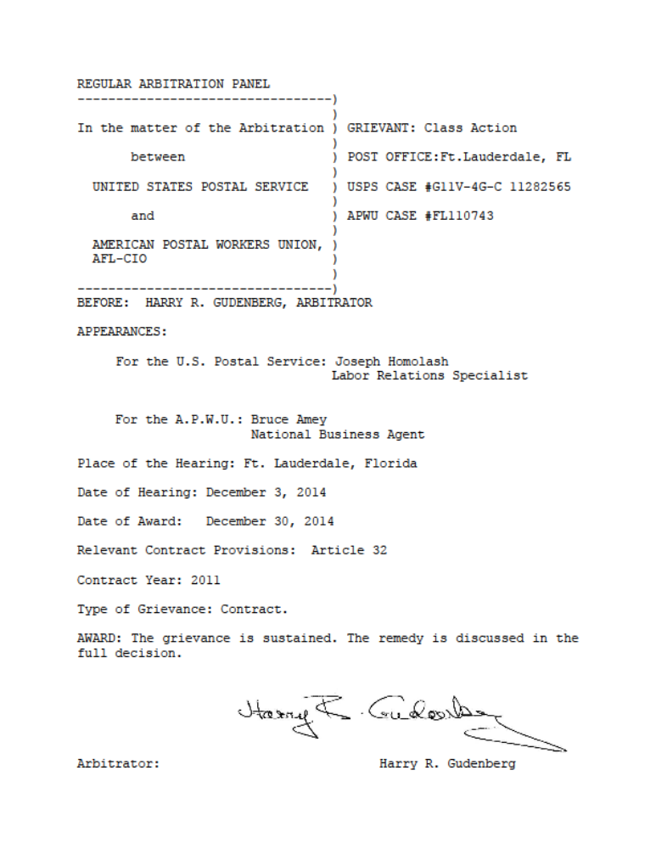
Article 32.1.C Notification
AWARD
The grievance is sustained. The remedy is discussed in the full decision.
Without the availability of specific financial or employee work history data for the time period in the dispute before me and with the facts being undisputed as similar to the issues heard by Arbitrator Soll the remedy ordered in this dispute will follow the Soll determination, namely the Postal Service shall pay each of the employees involved in this grievance who were at work during the time period in this dispute as VMF mechanics a total of one work day of eight (8) hours of regular pay, minus taxes and other legally required deductions.

Slide 51
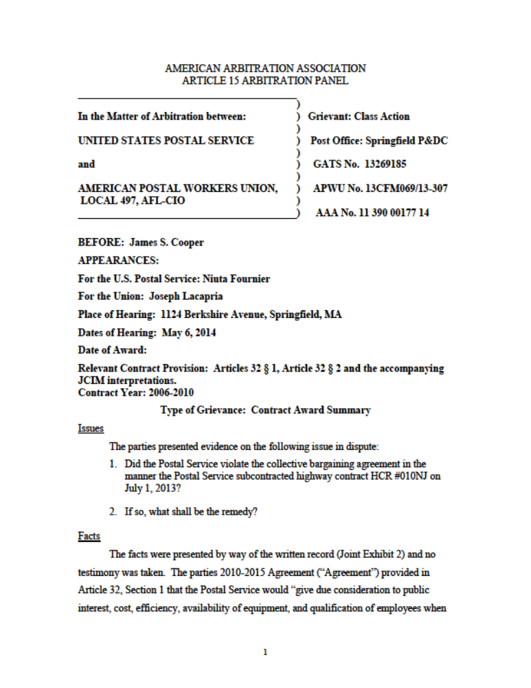
MOU on the 600 HCR Coming back to Craft
AWARD
The following is hereby awarded:
1. The Postal Service violated the collective bargaining agreement in the manner the Postal Service subcontracted highway contract HCR #010NJ on or about November 1, 2013.
2. As a remedy, the Postal Service shall cease and desist from renewing HCR #010NJ upon its current expiration date and shall thereafter return that work to PVS work

Slide 52
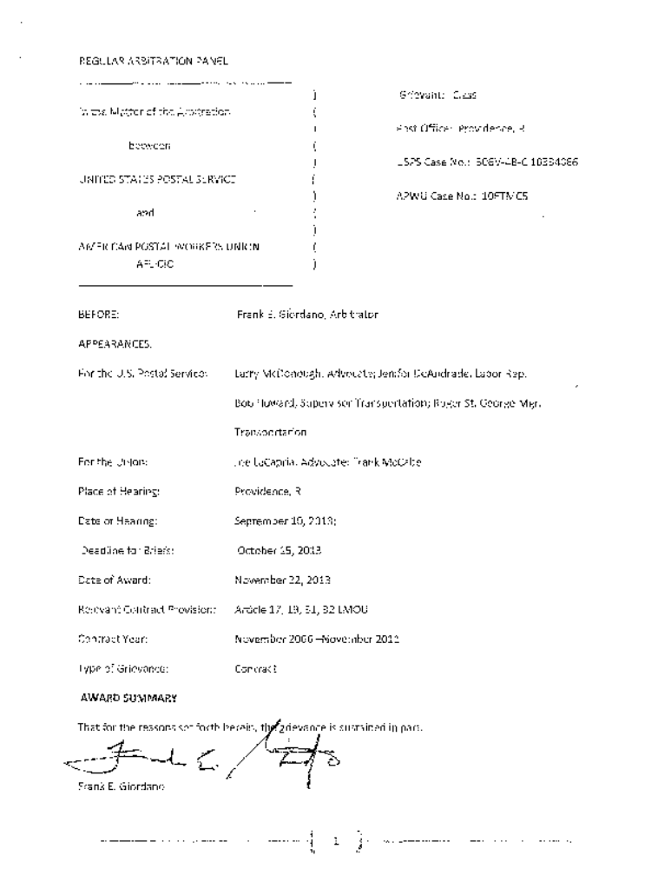
Article 32.1.C Notification
REMEDY
The remedy requested by the Union is granted in part. The Employer will cease and desist contracting out transportation of mail before notifying the Local American Postal Workers Union, giving the PVS in the Providence facility first consideration to perform the duties. The Employer will give consideration as to whether the MVS craft can perform the transportation of mail from Providence to Highland Station and Somerset Post Office. This will be done in a manner that conforms to the requirements of Article 32 of the Collective Bargaining Agreement. There will be no monetary remedy.

Slide 53
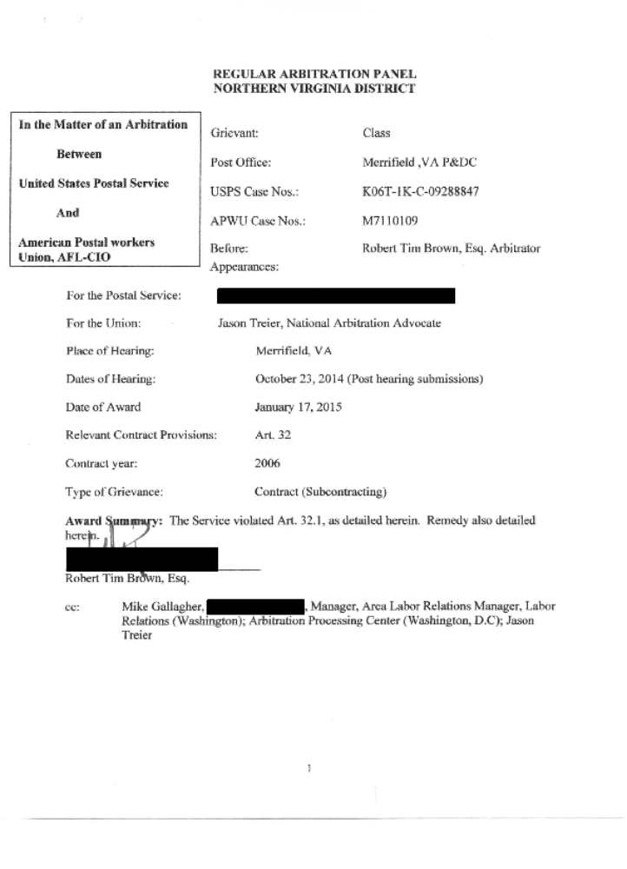
Article 32 5 Factors and Cost MOU
CONCLUSION AND AWARD
I conclude that the Service violated Art. 32.1 of the National Agreement in making its decision to subcontract this repair job at the Merrifield VMF, in that it did not give "due consideration" to the five listed factors in Art. 32, and more specifically could not have considered cost because even at hearing it was unaware of the cost of the subcontract.

Slide 54
Article 32 and Notification
AWARD
The grievance is sustained. The Postal Service violated Article 32 of the parties’ National Agreement by failing to provide the Union at the national level with adequate notice of its desire to renew 12 HCRs on July 1, 2008. The Postal Service is ordered to comply in the future with the notice provisions of Article 32 at its Southern Maine P & DC.
Award Summary
The grievance is sustained. The Postal Service failed to provide the Union with adequate notice of its intention to renew 12 Highway Contract Routes (HRCs) at its Southern Maine P & DC. To remedy the violation the Postal Service will be ordered to cease and desist from failing to provide the Union with adequate notice of its intention to renew HCRs at its Southern Maine P & DC and, in the future, to comply with the notice requirements of Article 32. No further relief was deemed appropriate or warranted under the facts and circumstances presented.

Slide 55
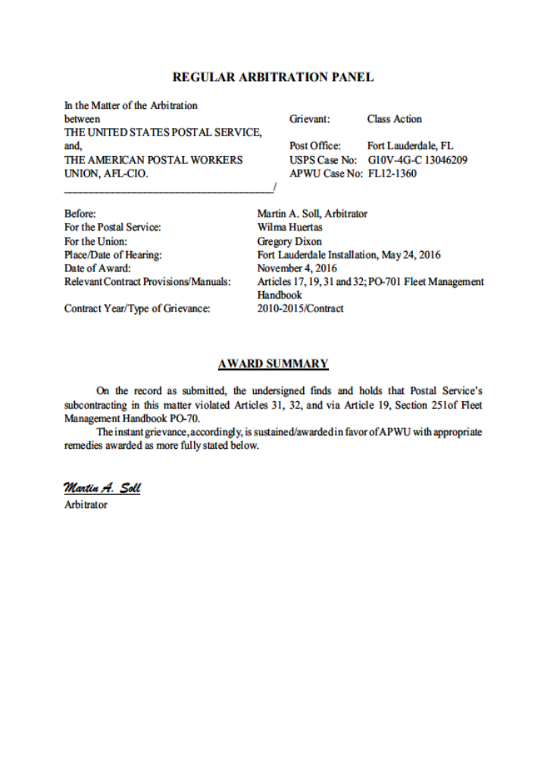
PVS to HCR and Non Notification
AWARD SUMMARY
On the record as submitted, the undersigned finds and holds that Postal Service’s subcontracting in this matter violated Articles 31, 32, and via Article 19, Section 251of Fleet Management Handbook PO-701.
The instant grievance, accordingly, is Sustained/awarded in favor of APWU with appropriate remedies awarded as more fully stated below.
In light of the above (which the undersigned concurs), the undersigned awards the below stated four “non monetary” appropriate remedies limited to those approximate twenty class members who have to the present time remained employed by Postal Service at any of its nationwide postal facilities.

Slide 56

Remedies
Along with filing a Grievance and having the proper documentation in the file for remedy this is just as important, as the violation in the Grievance. When making a statement of making the craft whole you must also include the documents to show they can be made whole. The Next pages of the training will go over the documents you need in the file for the remedy of the Grievance.

Slide 57
Remedy Paperwork
Overtime Desired List, this will show what employee are on the ODL for that quarter.
Overtime rotation list will show who is available.
Weekly schedules for the time frame within the grievance file.
Employee roster out of web coins.

Slide 58
Thank You
Joseph LaCapria, National Business Agent
Motor Vehicle Services Division
Tiffany, Foster, NE Regional Coordinator
Dyrike Shaw, National Business Agent
Motor Vehicle Services Division

